Slide 1

AI Assistant Development Project
A Project in Prompt Engineering
Creating an Intelligent Assistant with Web Technologies

Slide 2
Project Overview
Objective
Project Type
Showcase skills in crafting effective prompts and understanding how different prompts can drive various responses from an AI model.
Web-based AI Assistant capable of performing multiple intelligent tasks based on user input.
This project involves designing and implementing a basic AI Assistant that can perform a variety of tasks based on user prompts.

Slide 3
Key Requirements
1
Functionality
Perform at least three distinct functions
2
Prompt Design
Create multiple prompts for each function
3
User Interaction
Implement user-friendly interface
4
Feedback Loop
Include user feedback mechanism
5
Documentation
Provide clear user guide

Slide 4

Core Functionality
Answering Questions
Text Summarization
Responding to factual queries with accurate information
Condensing longer texts into concise summaries
Example: "What is the capital of France?"
Example: "Summarize this article about climate change..."
Response: "The capital of France is Paris."
Response: Provides a brief overview of key points

Slide 5

Additional Functionality
Content Generation
Providing Advice
Creating original content like stories, poems, or essays
Offering suggestions on specific topics
Example: "Write a short story about a dragon"
Example: "How can I improve my study habits?"
Response: Generates a creative story about dragons
Response: Provides practical study tips and strategies

Slide 6

Prompt Design Strategies
For each function, multiple prompts are designed to effectively guide the AI:
Varying Length and Specificity
Different Tones and Styles
Complexity and Context
Formal, casual, instructional, etc.
Simple queries vs. multi-part requests
From concise to detailed prompts
Example for question answering:
"What is Python?"
"Can you explain what Python programming language is used for?"
"Provide a detailed overview of Python, including its key features and common applications."

Slide 7
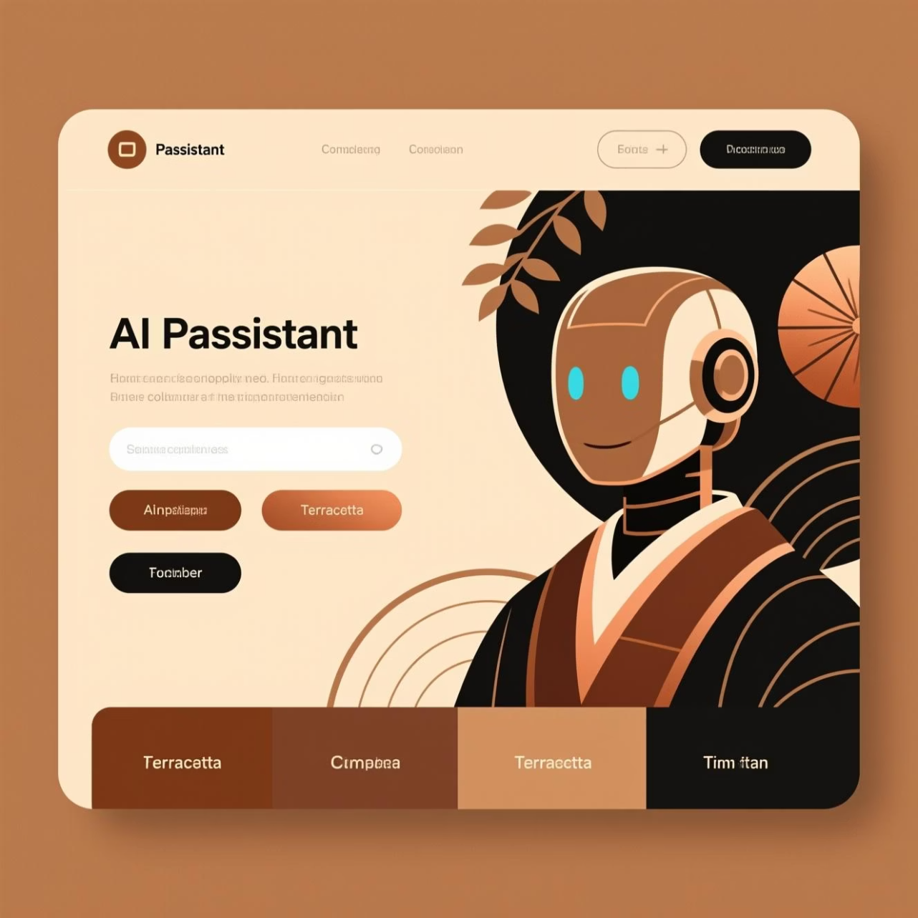
User Interface Design
The AI Assistant features a clean, intuitive web interface with:
Function selection buttons
Text input area for queries
Clear response display area
Feedback mechanism
Visual styling for enhanced user experience
Web Technologies Used:
HTML5, CSS3, JavaScript
Responsive design principles
Modern UI with gradient backgrounds

Slide 8








Feedback Loop Implementation
The assistant includes a mechanism for users to provide feedback on responses:
User Query
AI Response
User submits a question or request
Assistant provides an answer
Improvement
User Feedback
Refine prompt design based on feedback
"Was this response helpful? (Yes/No)"
// Feedback tracking example:let feedbackCount = { helpful: 0, notHelpful: 0 };// Update counts based on user input

Slide 9

Technical Implementation
Core Structure
Simulated AI Responses
HTML: Page structure and content
Since direct API access isn't available in this environment, the AI responses are simulated using predefined logic and pattern matching.
CSS: Styling and responsive design
JavaScript: Logic and interaction

Slide 10
Project Summary
Prompt Engineering Skills
Practical Application
Next Steps
This project demonstrates the principles of prompt engineering and how carefully designed prompts can elicit specific responses from AI models.
A functional web-based AI assistant showcasing multiple capabilities through effective prompt design and user interaction.
Expand functionality, refine prompt strategies, and implement more advanced feedback analysis.
AI Assistant Development Project - Prompt Engineering Course

